Slide 1
APUS H Unit One

Slide 2
Bering Strait – Land Bridge
Notes:
225 Million Years Ago - Pangaea started to break apart.
10 Million Years Ago - North America was shaped by nature - Canadian Shield
2 Million Years Ago - Great Ice Age
35,000 Years Ago - The oceans were glaciers and the sea level dropped, leaving an isthmus connecting Asia and North America. The Bering Isthmus was crossed by people going into North America.
10,000 Years Ago - Ice started to retreat and melt, raising the sea levels and covering up the Bering Isthmus.
Evidence suggests that early people may have come to the Americas in crude boats, or across the Bering Isthmus.

Slide 3
I. Pre-Columbian Societies
A. Early inhabitants of the Americas
B. American Indian empires in Mesoamerica, the Southwest, and the Mississippi Valley
C. American Indian cultures of North America at the time of European Contact
Notes:
American Indian Empires in Mesoamerica, the Southwest and Mississippi Valley

Slide 4
Mesoamerica
Notes:
Mesoamerica – today’s El Salvador, Nicaragua, & Mexico
Includes Mayans – most notably Aztecs
Chinampas (Aztecs) – draining swamps & placement of irrigation works “floating gardens”

Slide 5
Pueblo - Anasazi
Notes:
Southwestern – mostly associated with Pueblos and Anasazis
New Mexico area
Kivas – multistory stone and timer villages

Slide 6
Mississippi Valley
Notes:
Mississippi Valley settled along Mississippi River
Most notable tribe – Cahokia – spread North into Illinois
Earthen mounds
American Indian cultures of North America
Each regional area have permanent settlements because of corn – maize
Other crops like Squash, beans help
Society of Hunters & Gatherers
Doesn’t have weapons to ward of any European encounters
As well as European diseases

Slide 7
II. Transatlantic Encounters and Colonial Beginnings, 1492-1607

Slide 8
Portuguese

Slide 9
A. Europeans in Africa
1. Portuguese
1450s – sails coast of Africa
Begins in slave trade
Notes:
Europeans Enter Africa
People of Europe were able to reach sub-Saharan Africa around 1450 when the Portuguese invented the caravel, a ship that should sail into the wind. This ship allowed sailors to sail back up the western coast of Africa and back to Europe.
The Portuguese set up trading posts along the African beaches trading with slaves and gold, trading habits that were originally done by the Arabs and Africans. The Portuguese shipped the slaves back to Spain and Portugal where they worked on the sugar plantations.

Slide 10
Notes:
When Worlds Collide
Possibly 3/5 of the crops cultivated around the world today originated in the Americas.
Within 50 years of the Spanish arrival in Hispaniola, the Taino natives decreased from 1 million people to 200 people due to diseases brought by the Spanish.
In centuries following Columbus's landing in the Americas, as much as 90% of the Indians had died due to the diseases.

Slide 12
B. First European contacts with Native Americans
1. Columbus – within 50yrs after Portuguese
2. Treaty of Tordesillas
Spain and Portugal conflict over New World
Draw line – Treaty of Tordesillas – 1494
Has another 1520 regarding Pacific Ocean claims

Slide 14
Conquistadors
Notes:
The Spanish Conquistadores
In the 1500's, Spain became the dominant exploring and colonizing power.
The Spanish conquerors came to the Americas in the service of God as well as in search of gold and glory.
Due to the gold and silver deposits found in the New World, the European economy was transformed.
The islands of the Caribbean Sea served as offshore bases for the staging of the Spanish invasion of the mainland Americas.
By the 1530s in Mexico and the 1550s in Peru, colorless colonial administrators had replaced the conquistadores.
Some of the conquistadores wed Indian women and had children. These offspring were known as mestizos and formed a cultural and biological bridge between Latin America's European and Indian races.

Slide 15
C. Spain’s Empire in North America
Spain looks for God, Gold, and Glory
1. Conquistadors
Hernan Cortes – Aztecs
Francisco Pizzaro – Incas
2. “Black Legend”
Idea written by Bartolomeo de Las Casas
Spanish colonies include; South America, Central America, Caribbean areas, Florida, Southwestern America and California
Notes:
The Spanish were at Santa Fe in 1610.

Slide 16
French
Notes:
The French were at Quebec in 1608.

Slide 17
D. French Colonization
1. Edict of Nantes
French Huguenots tolerated BUT CANNOT leave France!
2. Canada
1603-1615; Samuel De Champlain; French explorer
1608 - “New France” = Quebec; becomes governor of Quebec
Late 1600s; Robert La Salle; explores Great Lakes region down Mississippi River.
Sets up New Orleans
French controls Mississippi River, valley and all trade
Notes:
instead of being persecuted by French Catholics

Slide 18
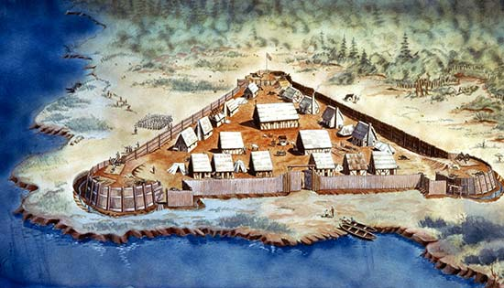

Slide 19
E. English Settlement of New England, the Mid-Atlantic, and the South
By 1607…
1. English’s Late arrival
England slow to explore
Henry VIII
Elizabeth I
English motivation for colonization
Population growth = unemployment
Religious Freedoms
Political freedoms
Notes:
England's Imperial Stirrings
King Henry VIII broke with the Roman Catholic Church in the 1530s, launching the English Protestant Reformation, and intensifying the rivalry with Catholic Spain.
Elizabeth Energizes England
In 1580, Francis Drake circumnavigated the globe, plundering and returning with his ship loaded with Spanish booty. He had a profit of about 4,600%.
When the English fleet defeated the Spanish Armada, Spain's empirical dreams and fighting spirit had been weakened - helping to ensure the English's naval dominance over the North Atlantic.
England on the Eve of an Empire
Because an economic depression hit England in the later part of the 1500s and many people were left without homes, the stage was set for the establishment of an English beachhead in North America.

Slide 21
Notes:
The English were at Jamestown, Virginia in 1607.

Slide 22
2. 1607 – Jamestown
1606; joint stock company – Virginia Company of London
Landed in Jamestown – 1607
1608 – Captain John Smith
Winter of 1609-10 – “Starving Time”
Anglo-Powhatan Wars – *
1612 – John Rolfe
Introduction of tobacco – saves Jamestown
1619 – introduction of African slaves
1619 – Virginia a self-government
House of Burgess
Notes:
*By 1685 Powhatan people are extinct

Slide 23
Maryland

Slide 24
3. Maryland – Proprietary Colony
1634 – Maryland – Lord Baltimore; separation of church and state
Maryland – refuge colony for Catholics –
1649 – Act of Toleration; granted toleration of ALL Christians in Maryland

Slide 25
Carolinas

Slide 26
4. Carolinas
Carolinas – its major crop is Rice
Sugar becomes major crop in British West Indies
Need for labor; African slaves brought in
Barbados Slave Code – 1661 – to control slaves
Native Americans move to Penn and MD

Slide 27
Tobacco & Slaves

Slide 28
F. From servitude to slavery in the Chesapeake region
1. Tobacco and indentured servants
Intro of Tobacco – saves Jamestown – main cash crop
Indentured servitude - # of years service for passage*
1630s – 1.5 mil pounds tobacco from Chesapeake
Indentured servants used – VA & MD employs “Headright system”
By 1700 – 100,000 to Chesapeake
Notes:
*BUT Chesapeake unhealthy environment

Slide 29
2. Slaves
1619 – African slaves to America via Dutch West Indies Co
New Amsterdam (New York) 1624 - 11 slaves brought for labor
1640 – change in status of Africans
Most from West Coast Africa (Senegal, & Angola)
1662 Slave codes exist in VA
1680s – no more indentured servants, available; fear of rebellions of indentured*
South Carolina – 2:1 Africans to whites
Carolina colony slaves from Barbados
Rice in Carolinas – cash crop, influx of African slaves
Notes:
*1698 – Royal Africa Co losses monopoly to slave trade

Slide 30
Puritans

Slide 31
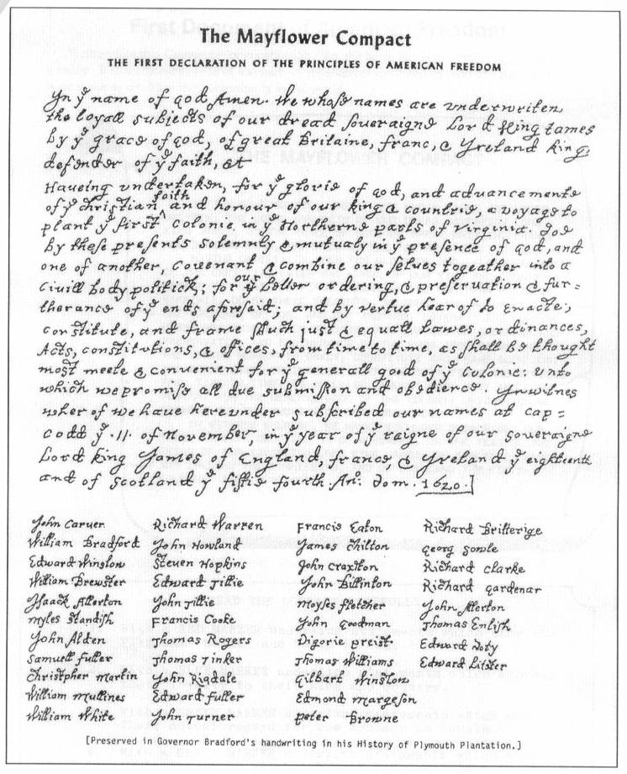

Slide 32
G. Religious Diversity in the American colonies*
1. Puritans & Separatists
Church of England – reformers wanted to “purify” English Christianity
Puritans –poorer folks; hope w/message of divine plan
Known as Separatists (Pilgrims) leave Church of England – Netherlands in 1608 – then onto Mass 1620
2. 1620 MAYFLOWER & Mayflower COMPACT
Set of governing rules
“beaver and the bible”
1st Thanksgiving 1621
William Bradford – governor of Plymouth (elected 30 times)
Notes:
*The Protestant Reformation produces Puritanism
Martin Luther & John Calvin

Slide 33
3. Puritans – 1630s
Puritans – 1629, royal charter – Massachusetts Bay Company
1630s mass migration – many go to West Indies
John Winthrop
1st governor – non democratic; only freemen can vote
Representative assembly – GENERAL COURT
Visible Saints – only church members, thus freemen
Covenant w/God & agreement to build holy society
Mass. prospers with fur trading, fishing, and shipbuilding

Slide 34
Dissidents

Slide 35
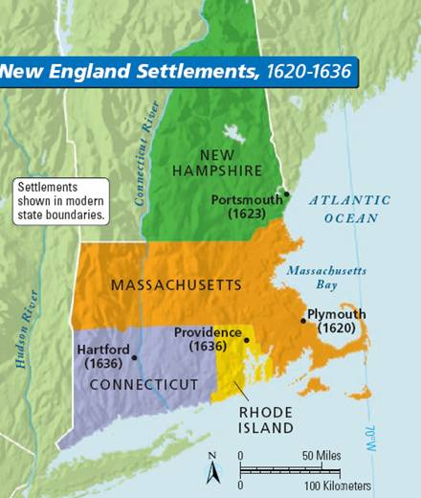

Slide 36
King Philip’s War

Slide 37
4. Other New England Colonies
Dissidents
Anne Hutchinson- (Antinomianism)
Roger Williams – Challenged the legality of the Bay Colonies Charter
Rhode Island – The SEWER of Massachusetts
Connecticut and Fundamental Orders
Hartford & Connecticut founded in 1635
1639 – new Connecticut River colony drafts Fundamental Orders
Basically a Constitution
New Haven in 1638.
1677, Maine bought by Massachusetts Bay
New Hampshire
1641, New Hampshire - fishing and trading, part of the Bay Colony, separated in 1679.
The spread of English settlements inevitably led to clashes with the Indians.
The Wampanoags at first befriended
Hostilities first erupted in 1637 between English & Pequot Tribe.
1675, King Philip’s War; destroys all forms of Indian resistance

Slide 38
H. Others in the New World

Slide 39
The Dutch

Slide 40
1. The Dutch
Dutch East India Company – Hudson river Valley
employed Henry Hudson – sails today’s Hudson Ri.
Dutch West India Company
maintained profitable enterprises in the Caribbean.
purchased Manhattan Island from Indians for $24
New Amsterdam - 1623-1624
New Amsterdam, later New York, controlled by Dutch company and for Dutch company
Notes:
Friction with English and Swedish Neighbors
New England was hostile to the growth of its Dutch neighbor, and the people of Connecticut finally ejected intruding Hollanders from their verdant valley. 3 of the 4 member colonies of the New England Confederation were eager to wipe out New Netherland with military force. Massachusetts, providing most of the troops, rejected this.
Dutch Residues in New York
In 1664, the Dutch were forced to surrender their territory (New Netherland) to the English when a strong English squadron appeared off the coast of New Amsterdam. New Amsterdam was named New York, after the Duke of York.

Slide 41
Swedes

Slide 42
2. The Swedes
1638-55 Swedish on Dutch preserves
plants colony - New Sweden on Delaware River
1655 – Dutch sends out military expedition with Peter Stuyvesant as leader
Ousts Swedes
New England, Indians and the Swedish, hostile towards Dutch
Notes:
.
From 1638-1655, the Swedish trespassed on Dutch preserves by planting the anemic colony of New Sweden on the Delaware River.
The Golden Age for Sweden was during and following the Thirty Years' War of 1618-1648, in which its brilliant King Gustavus Adolphus had carried the torch for Protestantism.
Resenting the Swedish intrusion, the Dutch dispatched a small military expedition in 1655. It was led by the able of the directors-general, Peter Stuyvesant, who had lost a leg while soldiering in the West Indies and was dubbed "Father Wooden Leg" by the Indians. The main fort fell after a bloodless siege, whereupon Swedish rule came to an abrupt end.

Slide 43
Quakers and Pennsylvania

Slide 44
3. Quakers and Pennsylvania
Quakers in England
refused to support the Church of England w/ taxes
William Penn secured a grant of fertile land = Pennsylvania.
Penn's liberal land policy attracted heavy flow of immigrants
Tolerant Colony
Penn launched colony 1681 & bought land from Indians.
Freedom of worship was guaranteed
Pennsylvania attracted rich mix of ethnic groups.
By 1700 PA surpasses all but, MA and VA as most populous and wealthy
Notes:
Penn's Holy Experiment in Pennsylvania
A group of dissenters, commonly known as Quakers, arose in England in the mid-1600s. Officially, they were known as the Religious Society of Friends.
Quakers were especially offensive to the authorities, both religious and civil. They refused to support the Church of England with taxes.
William Penn was attracted to the Quaker faith in 1660. In 1681, he managed to secure from King Charles II an immense grant of fertile land, in consideration of a monetary debt owed to his deceased father by the crown. The king called the area Pennsylvania.
Quaker Pennsylvania and Its Neighbors
The Quakers treated the Indians very well. Many immigrants came to Pennsylvania seeking religious freedom.
"Blue Laws" prevented "ungodly revelers" from staging plays, playing cards, dice, games, and excessive hilarity.
By 1700, Pennsylvania surpassed all but Massachusetts and Virginia as the most populous and wealthy colony.
William Penn was never fully liked by his colonists because of his friendly relations with James II. He was arrested for treason thrice and thrown into prison.
In 1664, New Netherland, a territory along the Hudson River, was taken by the English and granted to Lord John Berkeley and Sir George Carteret. This grant that was given to Carteret and Berkeley divided the region into East and West New Jersey, respectively.
Berkeley sold West New Jersey in 1674 to a William Penn and his group of Quakers, who set up a sanctuary before Pennsylvania was launched.
In 1681 (the same year that Penn was given the region of Pennsylvania from King Charles II), William Penn and his Quakers purchased East New Jersey from Carteret's widow.
In 1702, the proprieters of East and West New Jersey voluntarily surrendered their governmental powers over the region to the royal crown after confusion began to arise over the large number of landowners and growing resentment of authority. England combined the two territories (East and West New Jersey) into one colony in 1702.

Slide 45
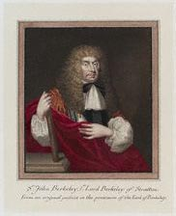
New Jersey

Slide 46
The Middle Way
Notes:
The Middle Way in the Middle Colonies
The middle colonies New York, New Jersey, Delaware, and Pennsylvania, were known as the "bread colonies" because of their heavy exports of grain.
These colonies were more ethnically mixed than any of the other colonies. The people were given more religious tolerance than in any other colonies.
Benjamin Franklin was born in Boston, Massachusetts in 1706. He moved to Philadelphia at the age of 17.

Slide 47
4. New Jersey
1664 – New Netherland near Hudson River
Divided region known as East & West New Jersey
1702 becomes a royal colony
5. Middle Way
The middle colonies = NY, NJ, DE, and PA.
Bread basket colonies
Fertile Soil
Forest for lumbering and shipbuilding.
Rivers and harbors = commerce and seaports.
Population - ethnically mixed & religiously tolerant and democratic control.
Benjamin Franklin

Slide 48
The Thirteen Original Colonies
Name Founded By Year
Virginia London Co. 1607
New Hampshire John Mason and Others 1623
Massachusetts Puritans 1628
Plymouth Separatists 1620
Maine F. Gorges 1623
Maryland Lord Baltimore 1634
Connecticut Mass. Emigrants 1635
New Haven Mass. Emigrants 1638
Rhode Island R. Williams 1636
Delaware Swedes 1638
N. Carolina Virginians 1653
New York Duke of York 1664
New Jersey Berkeley and Carteret 1664
Carolina Eight Nobles 1670
Pennsylvania William Penn 1681
Georgia Oglethorpe and other 1733

