Slide 2
APUS – Unit Two
1607-1783

Slide 3
A. Resistance to colonial authority: Bacon’s Rebellion, the Glorious Revolution, & the Pueblo Revolt
1. Bacon’s Rebellion
Freed indentured servants - no lands or equal rights.
1676 – 1000 Virginians led by Nathaniel Bacon resented Governor Berkeley’s policies towards Indians.
Bacon’s Rebellion – Class warfare
Crowd attacks Natives
Chases Berkeley out of Jamestown*
Africa for labor
Notes:
* Bacon dies of diptheria – rebellion dies out

Slide 4
2. Glorious Revolution 1688
A) Colonial Unity and Independence
1643 – formation on New England Confederation*
B) The 1st American Revolution
Dominion of New England
Promote and strengthen ENGLISH NAVIGATION LAWS
Sir Edmund Andros – “dictator”
1688 Glorious Revolution
1691 Massachusetts a Royal Colony
3. Pueblo Revolt – 1680 (Pope’s Rebellion)
Brutality of Spanish, & rise of taxes
Revolt - drove Spanish settlers out – churches destroyed
Defeated by Spanish 12 yrs later**
Notes:
* Primary purpose – defense vs foes
**Compromise

Slide 5
Religion, Population Growth & Immigrants

Slide 6
B. Religious Diversity in the American colonies
1. Puritans – 1630s
Churches & democracy in Congregational Church
Congregationalists
Mid 17th C – new Puritan sermons
“Jeremiad”
1662 “Half-way Covenant”
Salem, Mass.
Conflicts on frontier →many coming into towns like Salem
Salem Witch trials

Slide 7
C. Colonial North America – 1690-1754
Contributing factors – natural reproduction, immigrants, and slaves. Population doubled every 25 years.
1. Population growth and immigration – early years difficult
2. New England residents:
3. New England – families migrated together.
Women married young – average 6-10 children
Women’s roles
Men’s roles
4. Puritan lawmakers –women have no separate property rights
Man dies, church got the property
5. Towns with 50 families – elementary schools
Dominated by Congregationalists
College highly regarded in NE
Honored profession – ministry; Hated – Lawyer

Slide 8
6. Chesapeake – Single men
7. Indentured servitude
1625
74% pop were men
10% women
16% children
Bad environment – most don’t live to 20yo
8. Tobacco industry – growth of population because of labor – indentured women
Women – married young – married often
9. Other reason for growth – slaves.

Slide 10
D. Transatlantic trade & the growth of Seaports
King pays little attention to the American colonies
1. Late 15th C – 16th C; Columbian Exchange
New foods from New World to Old World
2. MERCANTILISM
Raw materials (NW)→ to old world = manufactured, → sold to Africa & new world
3. Need for labor – African slaves
Middle Passage - 12% mortality rate *
Notes:
* Become semi-autonomous commonwealths.

Slide 11
4. New England soil = rocks
NE people - experts in ship-building and fishing*
5. Mid 1700s, - richest 10% Bostonians and Philadelphians owned 2/3rds of city’s wealth.
6. 1730s – Americans demanding more British goods – too slow;
US looks to foreign markets
Molasses Act passed to stop trade with French West Indies
7. Working America were farmers - 90% of ppl
Tobacco in VA & MD; Grain in Middle colonies
Fishing & trade
Manufacturing only secondary
Notes:
* Atlantic Circuit – new products, labor system, new transportation, new lands, capitalistic enterprise = global exchange

Slide 12
E. The 18th C back country
1. 18th c back country - Resentment of upper-class sparked outbursts*
Leisler’s Rebellion – NY, 1689-91; bloody insurgence against landholders
2. Mingling of Race
By 1775 VA, MA, PA, NC & MD most populous
Colonial America original “melting pot”
Germans = 6% of white immigrants while Scots-Irish = 7%
Germans settled in PA
Many Scots-Irish settled near Appalachian foothills
3. With new immigrants – protests occur
March of Paxton Boys in Philly 1764
Regulator Movement in NC *(AJ)
4. Other European Immigrants
French Huguenots, Welsh, Dutch, Swedes, Jews, Irish, Swiss & Scot Highlanders
Notes:
#1. Many colonies tried to keep people in their places
*Maryland’s Protestants up rise
#4 Many not fond of the English – back-country - gives a sense of independence away from English gentry, etc.

Slide 13
F. Growth of plantation economies and slave societies
1. Growth of plantation economies and slave societies
Prior to American Revolution –
70% leaders of VA legislature from First Families of VA
Social Scale
Great planters – owned lrg #s of slaves, & vast lands; ruled regions economy & politics
Small Farmers – lrgst social grp; worked on own land, may have 1-3 slaves
Landless Whites – former indentured servants
2. Slaves
By 1720 – female population rise in Chesapeake area
SC coast, Africans evolve language GULLAH
NYC 1712 – slave revolt, with 12 whites and 21 Africans killed
1739 SC – Stono Ri.

Slide 14
G. The Enlightenment & the Great Awakening
1. Enlightenment – Age of Reason
Locke, Montesquieu
2. “Established” churches = tax-supported churches
Anglicans – official faith in GA, NC, & SC, VA, MD & part of NY
Congregationalists – grown fr Puritan Church, est in NE except RI
Religious toleration tremendous stride in America*
Notes:
*However few Catholics in America

Slide 15
3. Great Awakening – explodes in 1730-40s
Churches losing memberships
MA by J. Edwards; faith in God = eternal salvation
G. Whitefield; spread gospel t/o American areas
Old lights vs. new lights
Great Awakening = emphasis on direct, emotive spirituality.
Begins new American identity.
https://www.youtube.com/watch?v=n-dk4-HBNWQ

Slide 17
H. Colonial governments and imperial policy in British North America
1. Colonial governments and imperial policy in British North America
2. By 1775
8 colonies have royal governors
3 under proprietors
2 elected own governors
Nearly every colony had 2-house legislative body
Upper house = council; appointed by crown
Lower house = elected by the people
Not many governors popular

Slide 18
The American Revolutionary Era 1754-1789

Slide 19
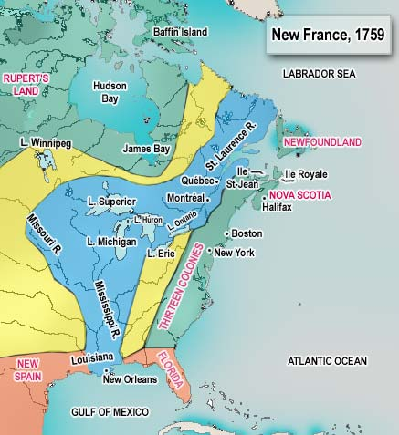
A. New France Sets Out
New France had beavers – fur trade
French Catholic priests – Jesuits goes to convert natives
Antoine Cadillac – founds Detroit in 1701
Robert La Salle – explores Mississippi & Gulf
Names Louisiana
To block Spanish on Gulf of Mexico
Founded New Orleans in 1718
Illinois – France’s garden empire of North America

Slide 20
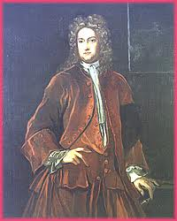
B. Clash of Empires
War btwn France & England to control North America in forms of 3 conflicts
King William’s War
Queen Anne’s War
Wars end 1713 with peace signed at Utrecht
France & Spain beaten
French lands like Newfoundland & Hudson Bay to England
1739 – War of Jenkins's ear btwn England & Spain
Small battle turns into large war = King George's War in America
1748 England wins – but returns Louisbourg – upsetting New Englanders

Slide 21
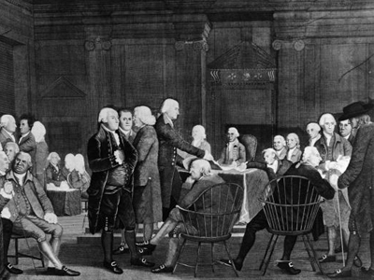
C. GW & War w/ France
1754 – G. Washington sent to Ohio Country to secure lands
Virginians surrender July 4, 1754 *
1755 – Brits uproot Acadians - moved to LA
French Indian War (7 Yrs War) starts 1754
Fought in Am, E, WI, Phil, Af, & on the ocean
In Europe – adversaries involved B & Pru, vs. F, S, A & R
Albany Congress
met 1754 – only 7:13 delegates met
Attempts to unite colonies
Notes:
*–after 150 killed

Slide 22
D. Braddock’s Blunder & Aftermath
1755 – General Braddock & Fort Duquesne
Brit forces slaughtered & Braddock dies
Entire PA & NC frontier open for attack
GW, w/300 men tried to defend area
1756 – British launches full-scale invasion of Canada

Slide 23
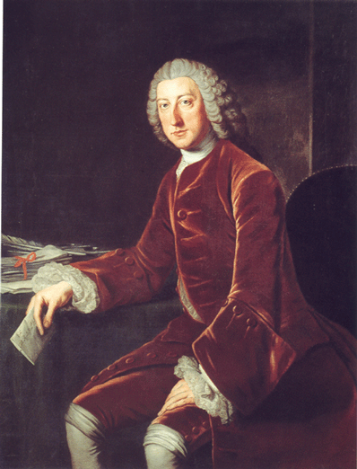
E. Pitt’s Victory & People of Destiny
1757 – William Pitt - leader in London gov
GB Attacks Louisbourg 1758
General James Wolfe for Battle of Quebec (1759)
Two sides on the Plains of Abraham – both leaders die
Montreal falls 1760
Treaty of Paris (1763)
Ends battle & French power out of North America
Inter-colonial disunity caused by enormous distances
Geographical barriers
Conflicting religions
Varied nationalities
Diff colonial govs
1763 – Ottawa chief, Pontiac led raids in Ohio country. Takes over Detroit.
England – Proclamation of 1763 – no settlement beyond Appalachians – colonists disregards.

Slide 24
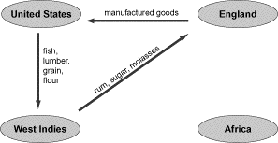
II. Road to Revolution
A. Deep Roots
1) Republicanism – citizens willingly submit their rights for common good.
2) Radical Whigs – grp of British political commentators; be on guard for corruption.
Mercantilism & colonial grievances begins w/ Navigation Laws of 1650
Colonial goods to Britain via British vessels
Aim to hurt Dutch rivals

Slide 25
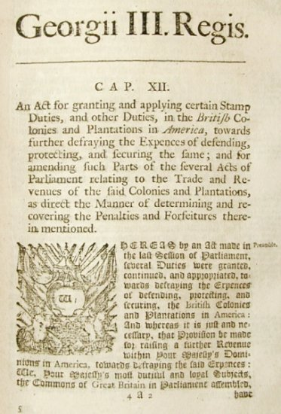
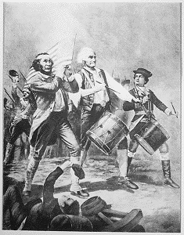
B. Stamp Act
Brits – lrg debt due to F-I war
1763 – new Brit PM – George Grenville
Orders strict enforcement of Navigation Laws
Secures fr Parliament – Sugar Act (1764)
Quartering Act (1765)
1765 – Grenville imposes Stamp Act
Used to raise revenue to support military
Stamp Act Congress 1765 – NYC
27 delegates fr 9 colonies
Drew up grievances; wanting king to repeal Stamp Act
Non-importation Agreements begins
Sons of Liberty & Daughters of Liberty enforces non-importation agreements
Stamp Act repealed 1766
But Declaratory Act passes

Slide 26
C. Townshend Acts & Massacre
1767 – Brit Parliament passes Townshend Acts
Tax on imported goods like glass & paper
1768 – 2 regiments landed in colonies → breakdown of laws
March 5, 1770 – 60 Bostonians attack redcoats who opened fire
Killing-wounding 11 men
Crispus Attucks
Called Boston Massacre

Slide 27
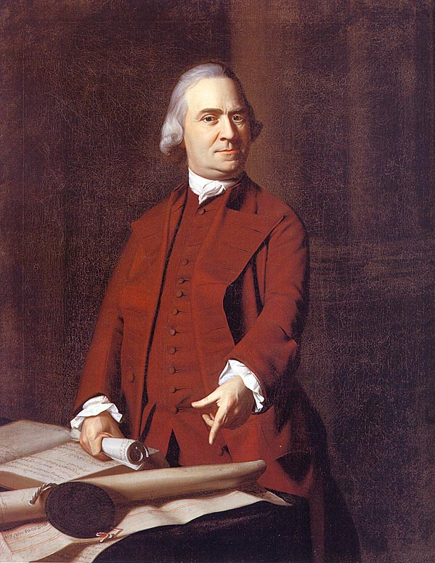
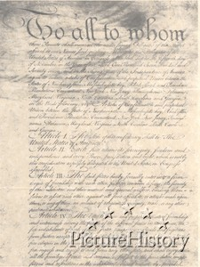
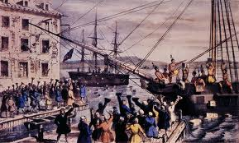
D. Committees & Tea Party
Lord North, persuades Parliament to repeal Townshend Acts
Samuel Adams, formed 1st local committee of correspondence in MA 1772 (SoL)
Created by Am colonists to maintain communication w/others
March 1773, VA House of Burgess
proposed each colonial legislature appoint standing committee for correspondence
1773 – British East India Co – overstocked w/ 17 million lbs of tea.
London govt gives co. full monopoly
Boston harbor; Gov T. Hutchinson forces citizens to let ships unload tea
Dec. 16, 1773, Boston Tea Party

Slide 28
E. Intolerable!
1774; Parliament punishes MA ppl for Boston Tea Party
Parliament passes Intolerable Acts
Restricts’ colonists rights
Restrict town mtgs
Boston Port Act; closes Boston harbor
Quebec Act 1774;
Catholic French Canadians religious freedom
Nullified Western claims of coast colonies

Slide 29
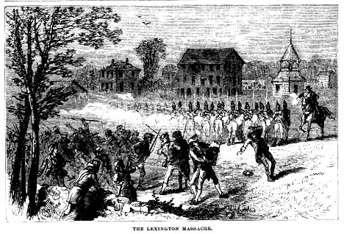
F. Continental Congress
1774, 1st Continental Congress
Met in Philly, PA - redress grievances over Intolerable Acts
12 Colonies (no GA) 55 men
Drew up papers, including Declaration of Rights
Creation of The Association; called for complete boycott of Brit goods
April 1775; Brit commander to Lexington - seize provisions
Lexington Massacre; 8 Americans dead
Onto Concord, Brit forces met colonists resistance
300 casualties & 70 deaths
American Revolution begins

Slide 30
G. Imperial & American +/-
Britain’s pop 3xs Am pop
Brit has greater econ & navy
Same time of Am Rev, Ireland has rebellions, and French looking for revenge
Brit’s armies thinned out, not well supplied
Lord Dunmore, VA Royal gov; promises freedom for slaves if join Brit army
“Lord Dunmore’s Ethiopian Regiment”
Americans
French help from Marquis de Lafayette
Articles of Confederation was adopted in 1777;
1st form of government
Lack of money; creation of “Continental” paper money
Valley Forge, PA – an example of heroes
No food for 3 days
Winter 1777-78 –freezing
German Baron von Steuben shapes Am Continental Army

Slide 31
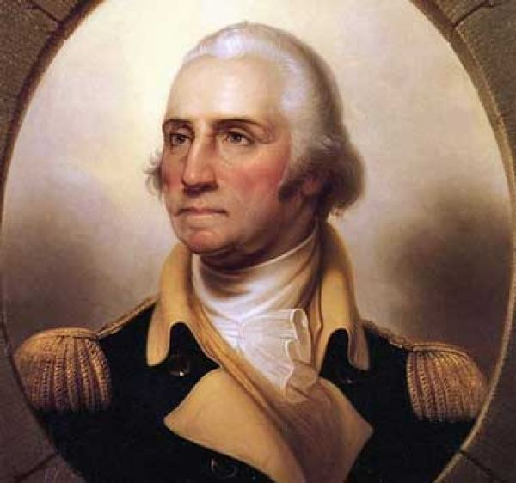
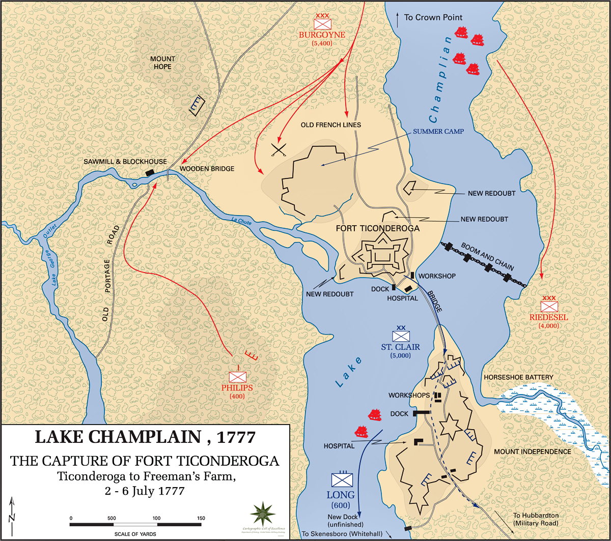
III. America Secedes from the Empire
A. Congress Drafts G. Washington
2nd Continental Congress selected G. Washington to head army
From April 1775 to July 1776, colonists on 2 sides
Professing loyalty to the king, yet raising armies
May 1775, Ethan Allen & Benedict Arnold captures Ticonderoga & Crown Point
Store of gunpowder & artillery
June 1775, colonists capture Bunker Hill
Brits get it back
July 1775; 2nd Continental Congress adopts “Olive Branch Petition”
Profession of loyalty to the king & begged to stop hostilities
King rejects
Colonists now need to fight for independence or submit to Brit rule
August 1775, George III proclaims colonists in rebellion
Hires German Hessians to bring order to colonists

Slide 32
B. Canada & Common Sense
October 1775; Brits burn Falmouth (Portland) Maine.
colonists attack Canada, but fail
January 1776, Brits set fire to Norfolk (VA?)
Many colonists still loyal 1
Thomas Paine – releases a pamphlet title Common Sense
Argued colonists outgrew English domination
should be given independence
Paine called for creation of a republic
Govt power flowed from the people.
Notes:
1. colonial unity very poor & open rebellion was dangerous

Slide 33
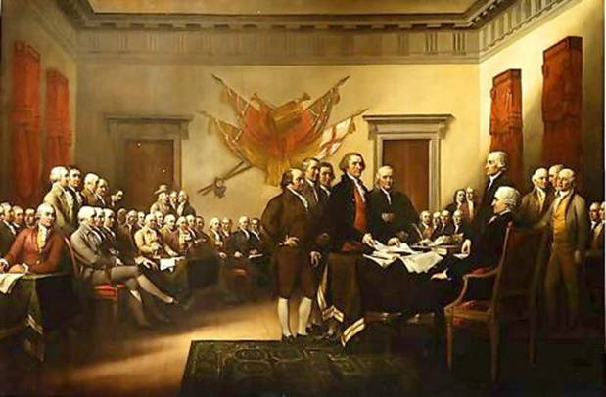
C. Jefferson’s Declaration of Independence
July 2, 1776, VA Richard Henry Lee’s resolution of independence passes
Was formal declaration
Thomas Jefferson, appointed to draft Declaration of Independence
Formally approved July 4, 1776 by Congress
28 paragraphs explaining wrongs done by King

Slide 34
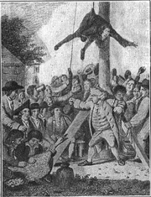
D. Patriots & Loyalists
During war – Loyalists = “Tories”
Patriots = “Whigs”
Loyalists made up of 16% of Am pop.
Many educated, wealthy, many Anglican
Mostly in cities like NY, Charleston, Quaker Penn, & NJ
Least numbers in NE
Patriots – numerous
Presbyterianism & Congregationalism flourished in NE
Loyalists were treated mildly in beginning
After DoI, treated harshly, even hanged.
Notes:
- Many forced to leave

Slide 35
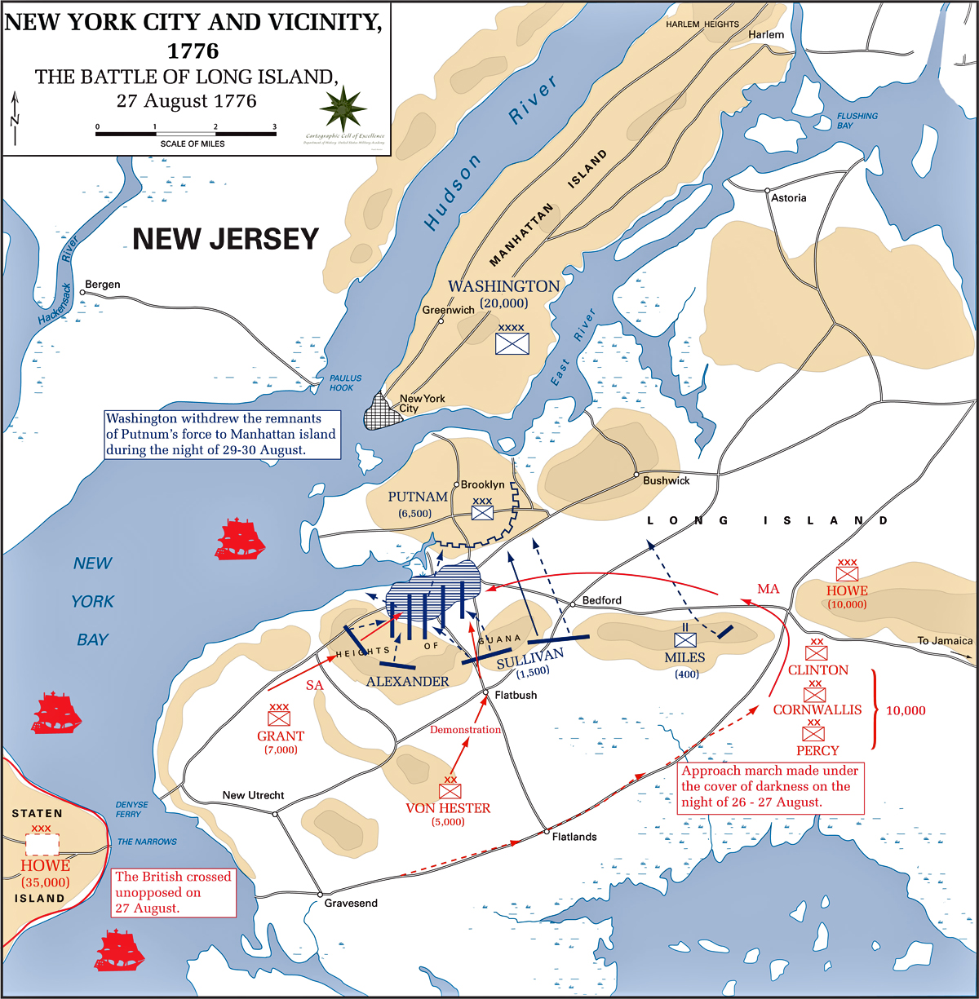
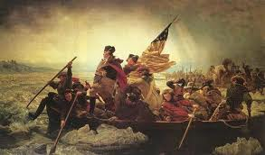
E. Washington @ Bay; Burgoyne’s Blunder
Brits concentrated from NYC
1776 – GW overpowered by Brits in Battle of Long Island
GW goes to Manhattan
General Wm Howe GW’s foe
Dec. 26, 1776, GW surprises Hessians
England tried to separate NE from rest of colonies
General Burgoyne (B) from Lake Champlain, and General Howe (B) in NY 1
Battle of Saratoga – Gen Burgoyne surrenders to Horatio Gates on Oct. 17, 1777
Urgent win for Colonists – brings in France for support
Notes:
1. if needed could advance

Slide 36
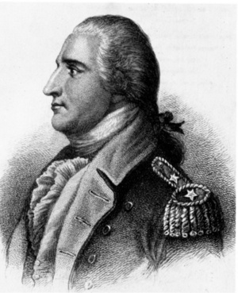
F. Strange Bedfellows & war goes global
G. Bad news & the Frontier
General B. Arnold, turns traitor
General N. Greene succeeds in clearing Brits out of GA & SC
Treaty of Fort Stanwix –
1784; 1st treaty btwn US & Indians signed by Iroquois
George Rogers Clark - plan to capture Brits in the wild of Illinois
John Paul Jones, father of the navy, employs privateering
France secretly supplies colonists
Brits offered home rule after Saratoga
France didn’t want Brits to regain colonies for fear of West Indies and sugar
1778 –France openly ally’s themselves w/ Colonists
Spain & Holland becomes allies against Brits by 1779
Brits evacuate Philly & concentrate in NYC

Slide 37
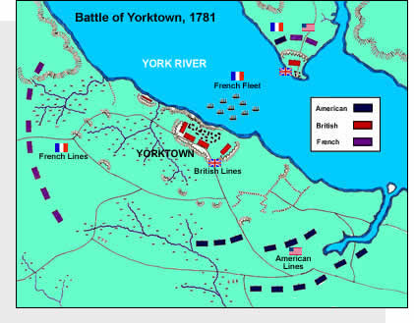
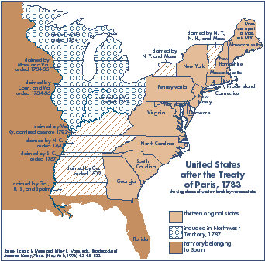
H. Yorktown & Final Curtain
1780-81; US govt nearly bankrupt
Brit General Cornwallis falls back to Chesapeake Bay at Yorktown & wait for reinforcements
Admiral de Grasse to assault Cornwallis by sea
GW w/ Rochambeau’s army corners Cornwallis
Surrenders October 19, 1781
Treaty of Paris 1783
Brits recognize USA’s independence
Florida to Spain
Brit grants boundaries
Yankees to retain fisheries in Newfoundland
Loyalists no longer prosecuted
BF, JA, & JJ negotiated peace treaty

