Slide 1
Northern Renaissance
Pieter Brueghel
(c.1525 - 1569)
&
Jan Van Eyck
(c. 1385 –1441)
Notes:
Pieter Brueghel generally considered the greatest Flemish painter of the 16th century. A number of Bruegel's paintings focus on the lives of Flemish commoners, which earned him the nickname "peasant Brueghel. Jan Van Eyck: was a Flemish painter active in Bruges and considered one of the best Northern European painters of the 15th century. He specialized in portraiture.

Slide 2
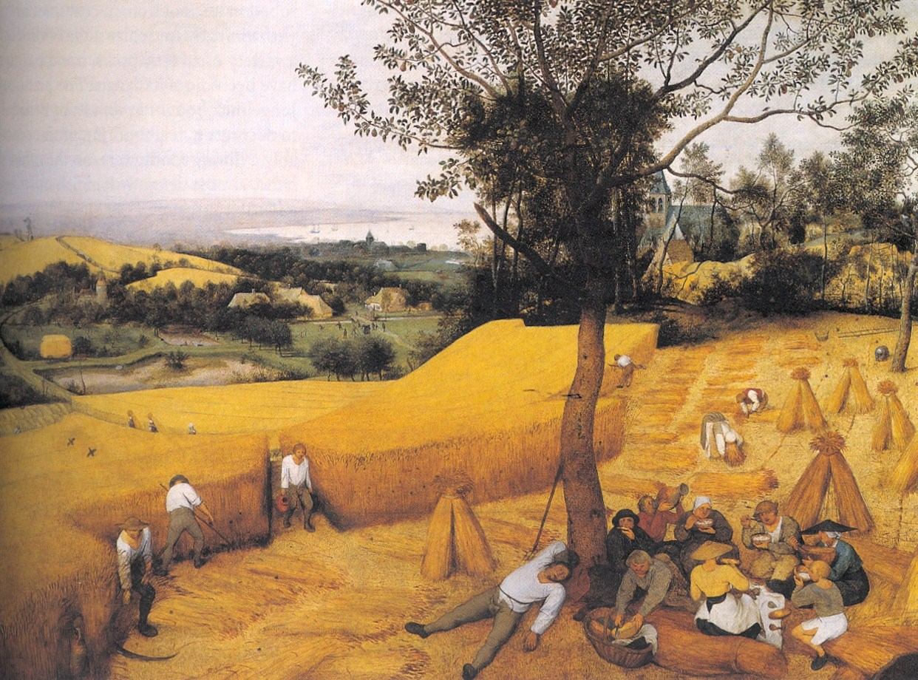
3
Notes:
The Harvesters 1565; Oil on wood - Pieter Brueghel's
Visual Arts – A History, Notes:
This picture was painted as one of a cycle of six pictures each which illustrated life on the land for two months a year.
It was commissioned by an Antwerp financier, Niclaes Jongelinck, a patron. He bought works of art for decoration & as financial assets.
Picture: group of peasants take a mid-day break in the shade of a tree, eating, drinking – one is sprawled asleep. Others a re still working, stacking corn, carrying sheaves. Through the trees is a glimpse of the village church, in the valley below a farm. Way in the back is the estuary. A man arrives through the path, carrying drink.
Note : the dominating yellow & green tones that reverberate through the picture – summer heat!
Antwerp: most prosperous city in the Netherlands under Spanish rule.
He traveled extensively in Italy & France between 1551 & 1553.
Bruegel’s art was admired for their truth to nature.

Slide 3
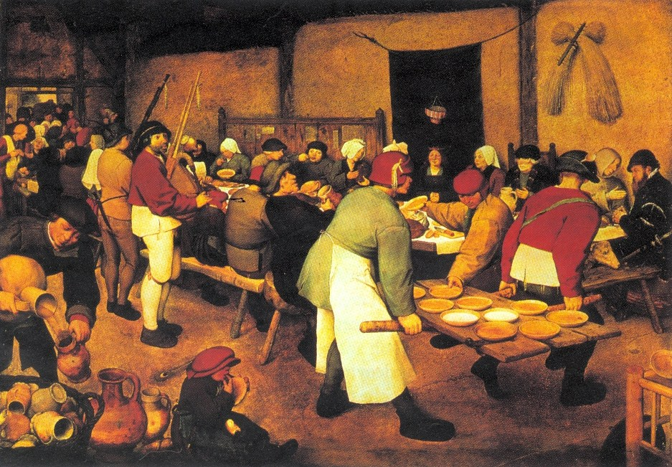
2
Notes:
Peasant wedding c. 1568
Items to note:
Strong characterized faces & postures of the figures
Seemingly causal composition cut off abruptly as the sides to suggest an instantaneous record.
Most prominent figures are tow robust burly cooks & their backs to the spectators, carrying food on a door wrenched from its hinges to serve as a try.
Bride sits red-cheeked, eyes half closed and hands clasped, ignored by the rest of the company, some who may be slyly mocking her. Is she pregnant?
At the right there is a well-dressed sword-bearing gentleman in conversation with a cowled friar, holding themselves aloof from the rowdy merrymaking throng.
Emphasize Bruegel created a new genre of painting – ones of landscape & atmosphere on a large scale. His figures a real life

Slide 4
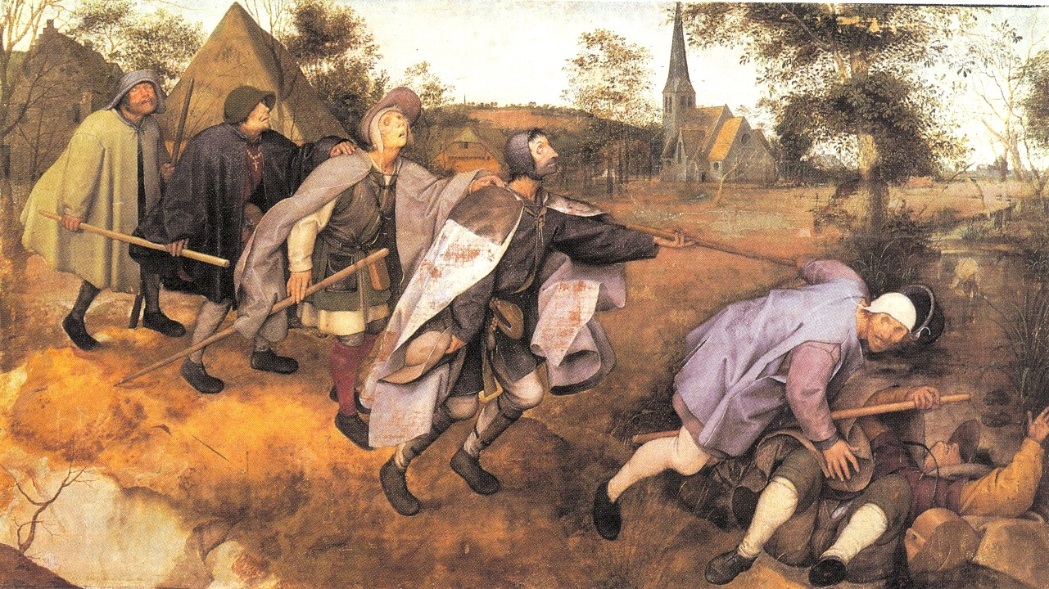
1
Notes:
Blind Leading the Blind, 1568, Tempura on canvas

Slide 5
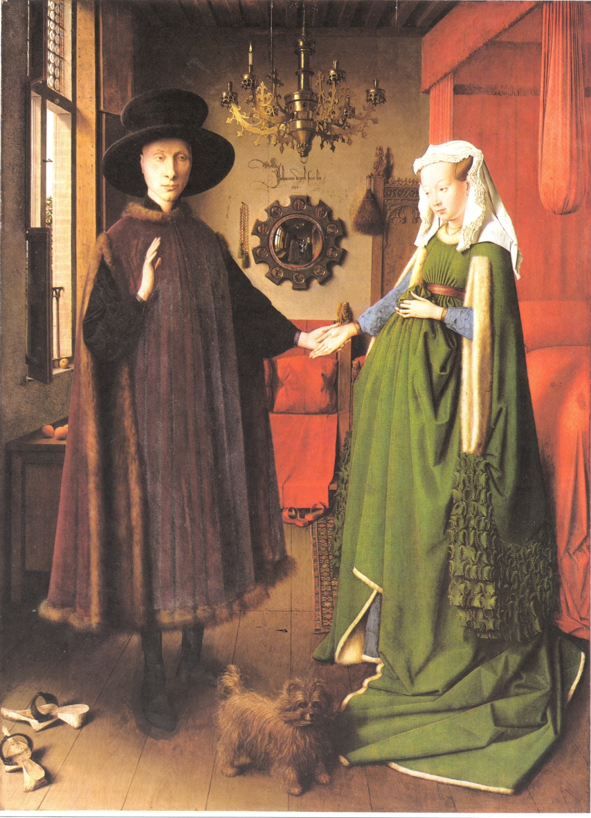
4
Notes:
Wedding Portrait, van Eyck, 1434
Giovanni Arnolfini, an Italian banker, and his wife., exchanging wedding vows in a home.
Pioneered: Realness of objects. Light entering through the window.
Small painting: 32 X 23 ½ inches – masterpiece of western art. It’s very innovative – couple faces the onlookers.
Objects symbolize message:
Rich in symbolism: Orange – fertility, dog infidelity, mirror – purity, burning candle – Christ, fruit – Virgin Mary.
No shoes on the couple – symbolizes holy ground.
Couple appears to be along, but not people reflected in the mirror on the center wall.

