Slide 1
Analyzing Late Cold War Events
Directions & Discussion

Slide 2
Cold War Events
You will be analyzing 8 events from the late Cold War period (1970-1990)
Remember the US used many methods for combating the spread of communism around the world -> Many Americans believed that Soviet-style communism was evil and denied basic human rights to those under its control. And the US gov’t wanted to export democracy and capitalism around the globe = more money and power for the US.

Slide 3
Directions
For each Cold War event, carefully read each placard. Write the name of the event in the first box.
Then, with your group, create and write in the second box a newspaper headline summarizing the event.
Finally, circle ALL the US method/s that are used in the event. ->Look at the US Methods During the Cold War handout to help you

Slide 4
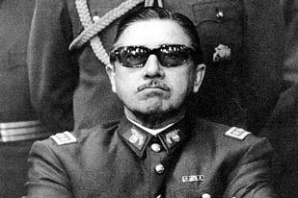
Event: Pinochet’s Coup in Chile

Slide 5
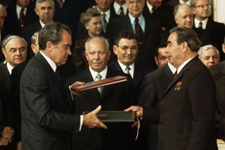
Event: Nixon’s Policy of Detente

Slide 6
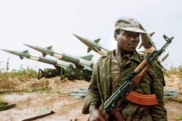
Event: Civil War in Angola

Slide 7
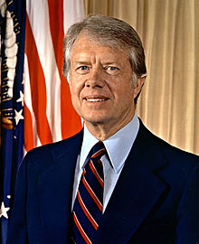
Event: Carter’s Human Rights Initiatives

Slide 8
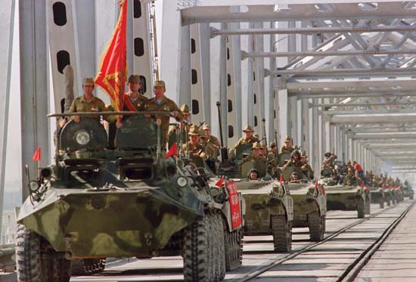
Event: The Soviet Invasion of Afghanistan

Slide 9
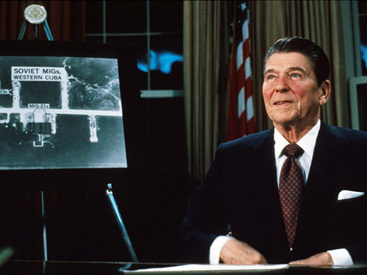
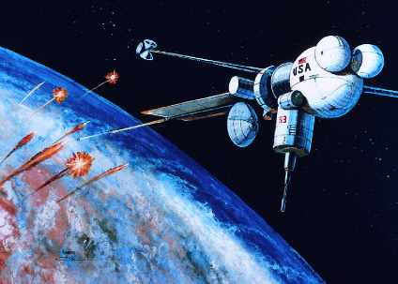
Event: Reagan’s Defense Buildup

Slide 10
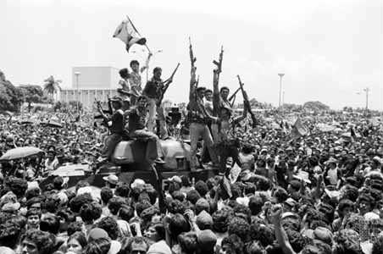
Event: Revolution in Nicaragua

Slide 11
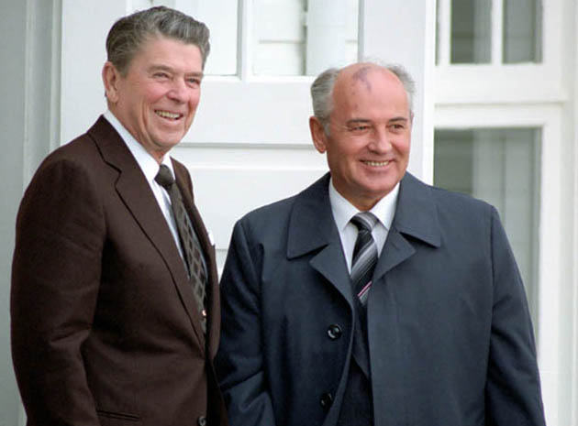
Event: The Reykjavik Summit

Slide 12
Discussion
What methods did the United States use most during the late Cold War?
Which methods were the most appropriate? WHY?
Which methods were totally inappropriate? WHY?
Do you think the United States lived up to its democratic principles during the Cold War? WHY OR WHY NOT?
Do you think the United States should be praised or condemned (blamed) for the methods it used during the Cold War? EXPLAIN.

