Slide 1
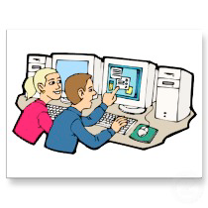
Welcome to S-1 Ms. Wong Computer Technology
Thank you for coming – Please sign in and find a seat!
Students are in computer for one semester, their second semester is either in Art or drama.

Slide 2
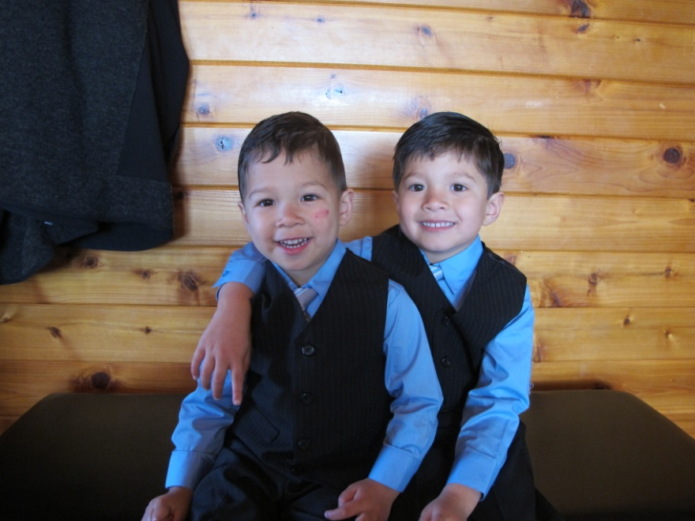
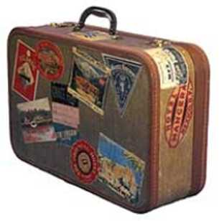
A Little About Mrs. Wong!
Education:
Westmont College (Bachelor’s degree)
Cal State East Bay (Master’s Degree)
Teaching for 20 years
3 years middle school math/science in Hayward/CV
1 year 7th Grade Self Contained
16 years at Wilson Elementary
3 years at Muir (computers/math)
Personal
Married with two sons
Culinary Degree as hobby
Love to Travel

Slide 3
Activities in Computer Class
Keyboarding Practice
~ 9 weeks
Webquests
1 week
Microsoft Word (drawing and word processing)
1-2 weeks
Excel (spreadsheets)
1-2 weeks
Photoshop/Powerpoint
3-4 weeks
Comic Life
1-2 weeks

Slide 4
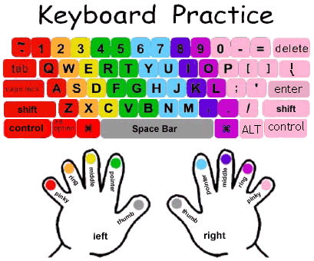
Keyboarding Practice ~ 9 Weeks
CC 7.6, 8.6: Use technology, including the internet, to produce, pubish and update individual or shared writing projects…
INCLUDES
www.edutying.com
Microsoft Word Processing
(page 1)
Practice at home
Activities and Games

Slide 5
Webquests
CC State Standard 7.8-8.8 Gather relevant information from multiple authoritative print and digital sources, using advanced searches effectively; access the credibility and accuracy of each source; and quote or paraphrase the data and conclusions of others while avoiding plagiarism…
Example: Page 2 - Plagiarism Web quest

Slide 6
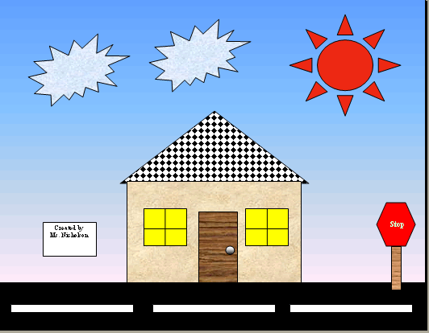
Microsoft Word
CCSS 7.6-8.6 Use of technology, including the internet to produce and publish writings…
Writing Stories
page 1 & 6
Drawing
Page 10 - 12

Slide 7
Microsoft Excel
CCSS 7.6 – 8.6 Use technology… to present the relationships between information and ideals clearly and efficiently
Spreadsheets
Page 14: Crossword Puzzle
Pg. 16: Merchandise Order
Pg. 8: Amazing Mazes

Slide 8
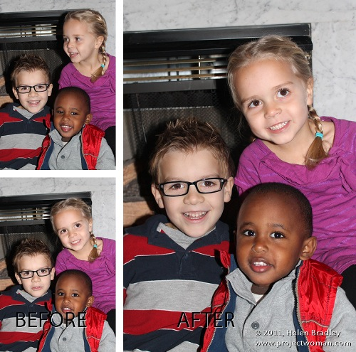
Photoshop/ Powerpoint
CCSS 7.7 Compare and contrast a text to an audio, video, or multimedia version of the text, analyzing each medium’s portrayal of the subject…
Pages 19-31 Students will
learn how to use Photoshop
to edit photographs
Powerpoint– students will
make a presentation and
evaluate their peers.

Slide 9
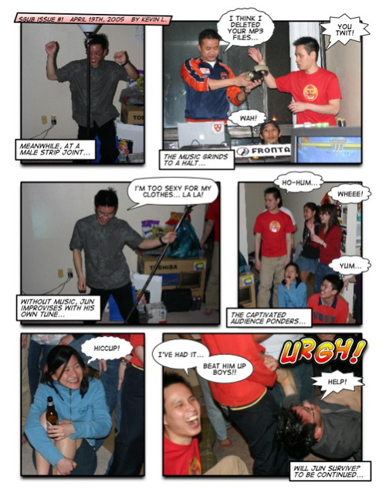
Comic Life
CCSS 7.5-8.5 Integrate multimedia and visual displays into presentations to clarify information, strengthen claims and evidence, add interest.
Page 34-37: We will present a variety of information in comic form.

Slide 10
Grading Policy
All class work makes up 50 % of a
student’s grade.
All quizzes/homework make up 10% of a student’s grade.
All projects make up 40% of a students grade.
EXTRA CREDIT: I do not allow extra credit. I feel it rewards students with poor study habits who do not put forth effort in class. I do however offer students to make up ANY assignment to receive a better grade !

Slide 11
THANK YOU!
Thank you very much for attending Back to School Night! You are the pivotal ingredient in your child’s success.
Please feel free to contact me at any time if you would like to discuss your child!

